Slide 1
ENCAPSULATION
A.NIKITHA
22H51A66D1
CSM

Slide 2
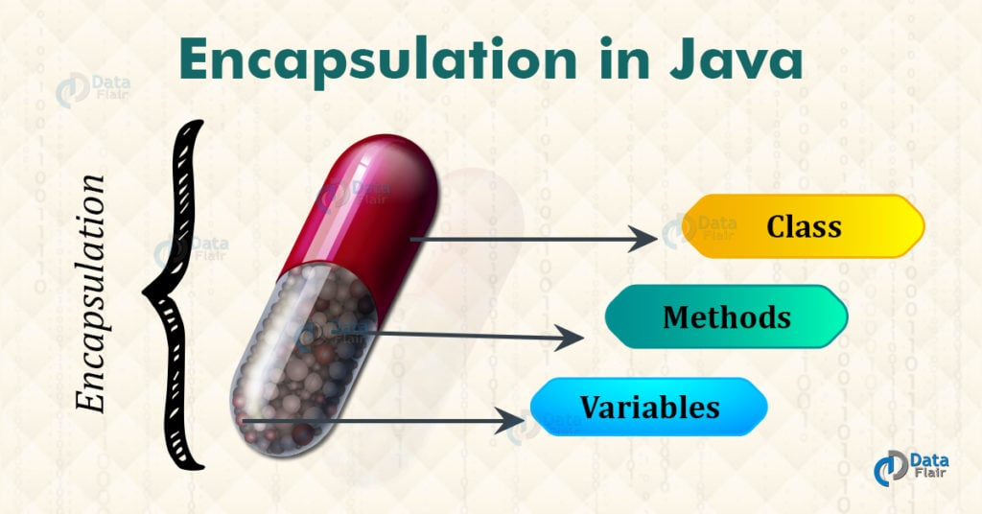
Introduction to Encapsulation in Java.
Encapsulation is the concept of bundling data (attributes) and methods (behavior) that operate on the data into a single unit known as a class.
It helps in data hiding, allowing access to data only through defined methods, thus ensuring data integrity and security.
Encapsulation promotes code reusability and maintainability by providing a clear interface for interacting with the class.
Notes:
Image source: https://data-flair.training/blogs/encapsulation-in-java/

Slide 3
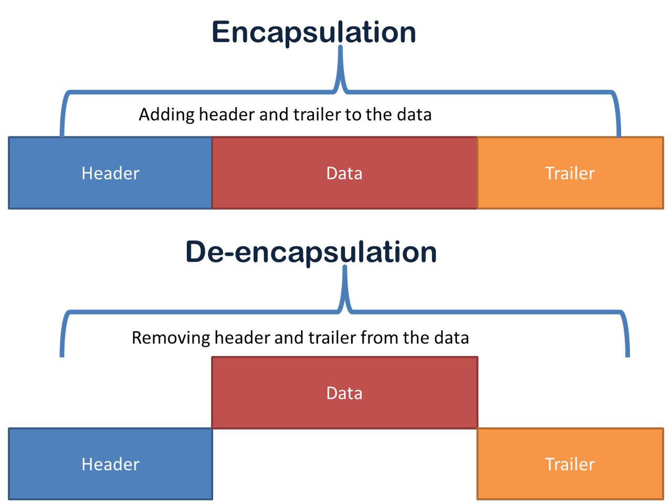
Benefits of Encapsulation
Encapsulation promotes data hiding, which helps prevent direct access to the internal state of an object.
It allows for better control over how data is accessed and modified, enhancing security and reducing the risk of unintended changes.
Encapsulation also improves code maintainability by encapsulating implementation details within a class.
Notes:
Image source: https://www.computernetworkingnotes.com/ccna-study-guide/data-encapsulation-and-de-encapsulation-explained.html

Slide 4

Encapsulation in Real-World Applications.
Encapsulation is widely used in software development to model real-world entities as classes with encapsulated data and behavior.
Examples include modeling bank accounts, employee records, and customer information using encapsulated classes in Java.
Encapsulation helps in creating modular, reusable, and secure software components that are easier to maintain and extend in complex applications.
Notes:
Image source: https://www.artofit.org/image-gallery/934989572616529244/encapsulation-in-java-with-realtime-example-and-its-advantages/

Slide 5
class Car:
def __init__(self, make, model):
self.__make = make
self.__model = model
def get_make(self):
return self.__make
def get_model(self):
return self.__model
def set_make(self, make):
self.__make = make
def set_model(self, model):
self.__model = model
my_car = Car("Toyota", "Corolla")
print("Make:", my_car.get_make()) # Output: Toyota
print("Model:", my_car.get_model()) # Output: Corolla
my_car.set_make("Honda")
my_car.set_model("Accord")
print("Make:", my_car.get_make()) # Output: Honda
print("Model:", my_car.get_model()) # Output: Accord
ENCAPSULATION EXAMPLE

Slide 6
EXPLANATION OF CODE
We define a blueprint for creating Car objects.
Each Car object has two private attributes: make and model.
When a new Car object is created, its make and model are set based on the provided values.
We provide methods to retrieve the make and model attributes of a Car object.
We also provide methods to modify the make and model attributes of a Car object.
These methods ensure that access to the attributes is controlled and encapsulated within the Car class.
We can create instances of the Car class and interact with them using the provided methods to access and modify attribute values.

Slide 7
EXPLANATION OF OUTPUT
We create a Car object with a make of "Toyota" and a model of "Corolla".
We retrieve and print the make of the car, which is "Toyota".
We retrieve and print the model of the car, which is "Corolla".
We then modify the make of the car to "Honda" and the model to "Accord".
We retrieve and print the updated make of the car, which is now "Honda".
We retrieve and print the updated model of the car, which is now "Accord".
The final output confirms that we successfully accessed and modified the attributes of the Car object using the provided methods.

Slide 8
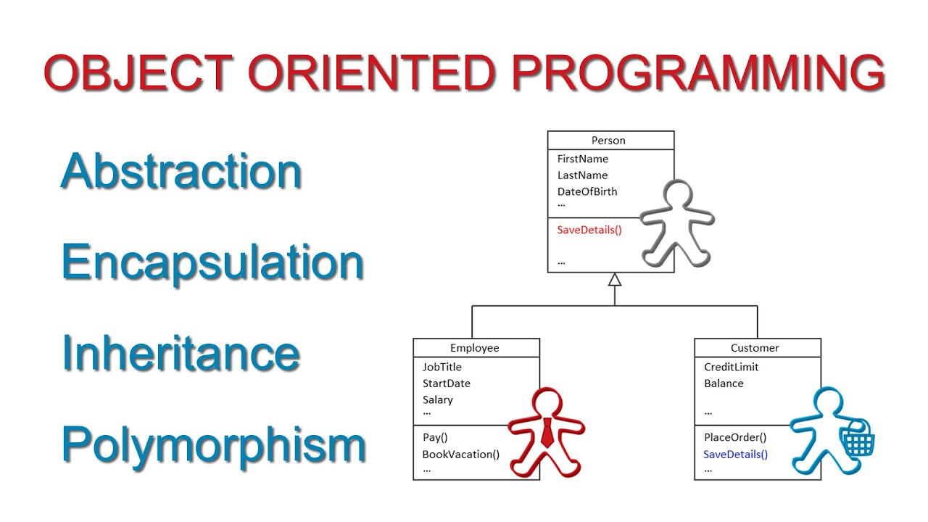
Conclusion.
Encapsulation is a fundamental concept in object-oriented programming that promotes data hiding, code reusability, and modularity.
By encapsulating data and behavior within classes, Java ensures data integrity, security, and maintainability in software development.
Understanding and applying encapsulation principles can lead to well-designed, flexible, and robust Java applications.
Notes:
Image source: https://www.youtube.com/watch?v=m_MQYyJpIjg?showiamp

Slide 9
THANK YOU

